Slide 1
Seed survival in storage: a deep dive into the factors that influence seed longevity
Fiona R. Hay
Aarhus University

Slide 2
Definitions
Seed longevity is the length of time seeds remain alive in a given storage environment:
  Seed storage experiments (where rate of ageing is accelerated);
  Genebank storage – medium-term storage (MTS) = active collection,
  – long-term storage (LTS) = base collection.
p₅₀ is often used as a measure of longevity: the length of time (‘period’, p) that it takes for the viability of a seed lot to fall to 50% in a given storage environment.
Whether seeds are alive (‘viable’) or not is usually determined by a germination test, but sometimes another viability test is used e.g. topographical tetrazolium staining test.
A genebank accession is a sample of plant material that is conserved to represent a particular variety / line / population. In many seed genebanks, each accession is usually represented by a sample of seeds in both the active and base collections.

Slide 3
Outline
A seed lot as a population of seeds, seed survival curves and genebank viability thresholds
Pre-storage factors that can impact the subsequent longevity of seeds when they are placed into genebank storage
Are current genebank storage conditions acceptable or not?

Slide 4
A seed lot is a population of seeds

Slide 5
A seed lot is a population of seeds
Vigorous germination Ageing symptoms Unable to germinate
100% fast, uniform germination
75-90%, slower germination
50-75%, slow less uniform germination
25-50% slow, sporadic germination
10-25% slow, abnormal germination
0% germination
Storage

Slide 6
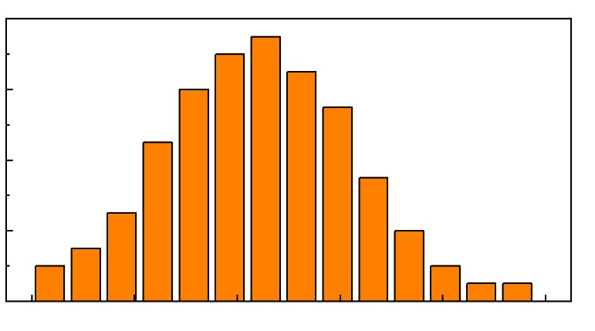
Timing of loss of ability to germinate varies
100% fast, uniform germination
75-90%, slower germination
50-75%, slow less uniform germination
25-50% slow, sporadic germination
10-25% slow, abnormal germination
0% germination
Storage

Slide 7
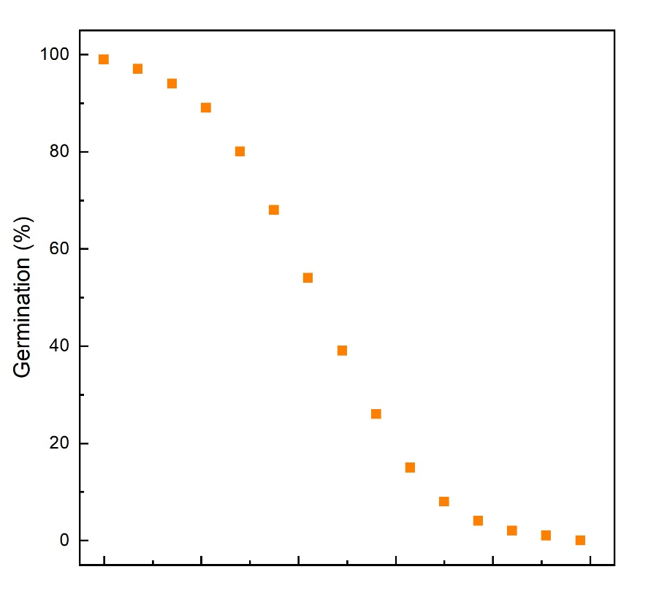
Timing of loss of ability to germinate varies
Seed survival curve
Storage

Slide 8
This is a good thing (for genebank managers)
Seed survival curve
Storage

Slide 9
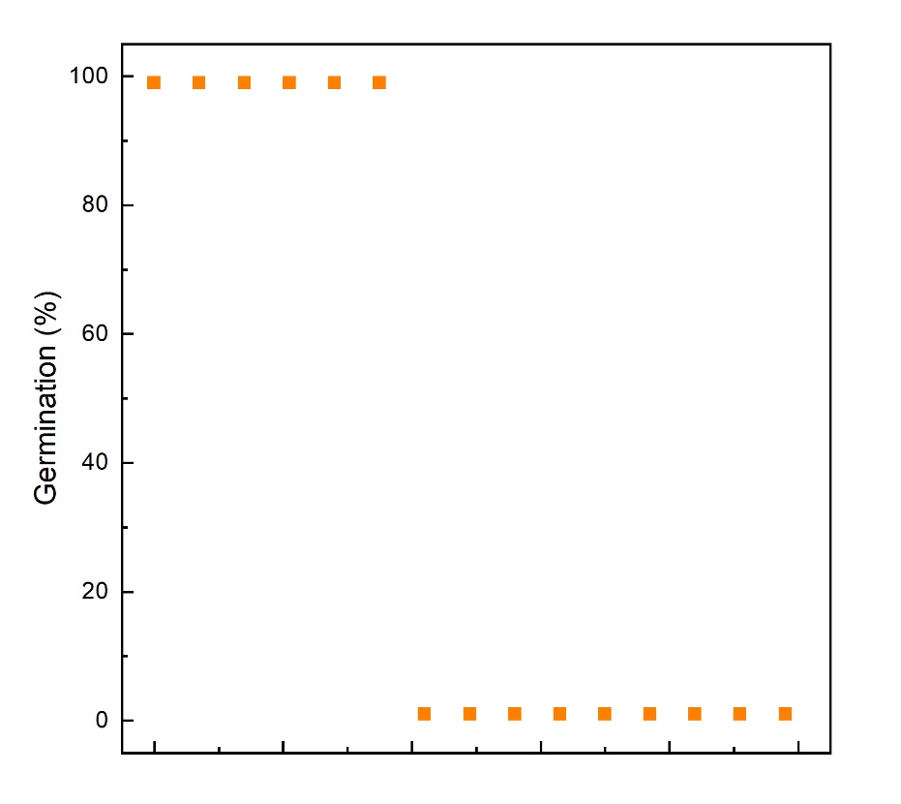
This is a good thing (for genebank managers)
Storage
Storage

Slide 10
This is a good thing (for genebank managers)
85% viability
threshold
Seed survival curve
Storage

Slide 11
Alternative viability thresholds?
Higher rates of rejuvenation
85% viability
threshold
Greater risk of losing genotypes
Recipients might achieve even lower germination
Storage

Slide 12
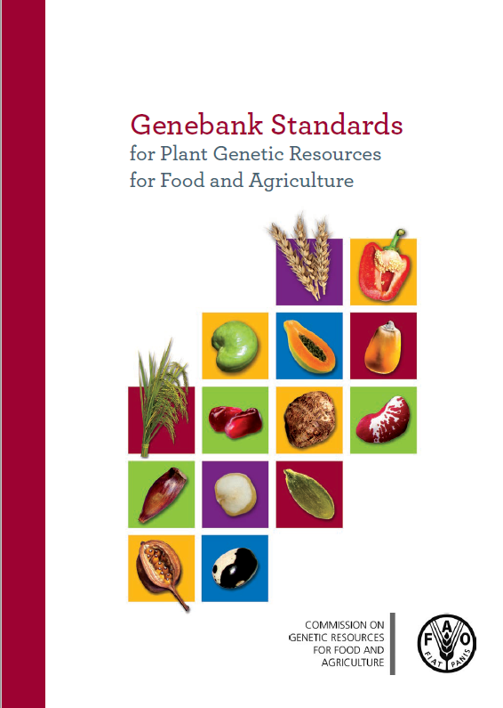
Alternative viability thresholds?
4.3.3 Viability monitoring test intervals should be set at one-third of the time predicted for viability to fall to 85% of initial viability or lower depending on the species or specific accessions…
4.3.4 The viability threshold for regeneration or other management decision such as recollection should be 85% or lower depending on the species or specific accessions of initial viability.
“For some landraces, specific accessions, wild species and forest species, a viability of 85 percent in newly replenished seed is rarely achievable. In these situations, the curator can set the viability standard trigger for selected species to a lower threshold, such as 70% or lower.” (FAO, 2014).

Slide 13
Alternative viability thresholds?
Higher rates of rejuvenation
85% viability
threshold
85% of initial
Greater risk of losing genotypes
Recipients might achieve even lower germination
Storage

Slide 14
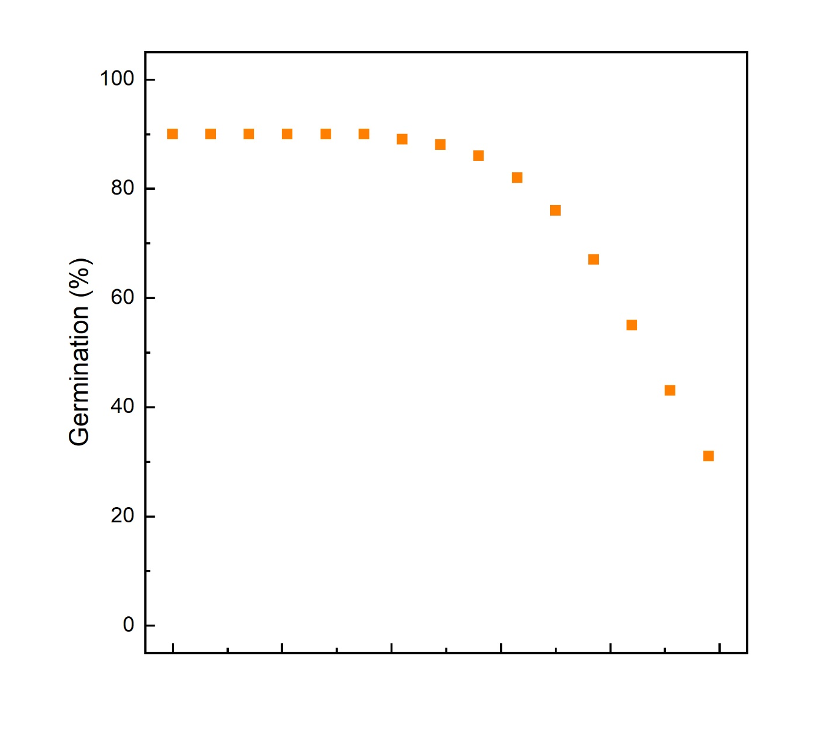
Alternative viability thresholds?
85% viability
threshold
85% of initial
Storage

Slide 15
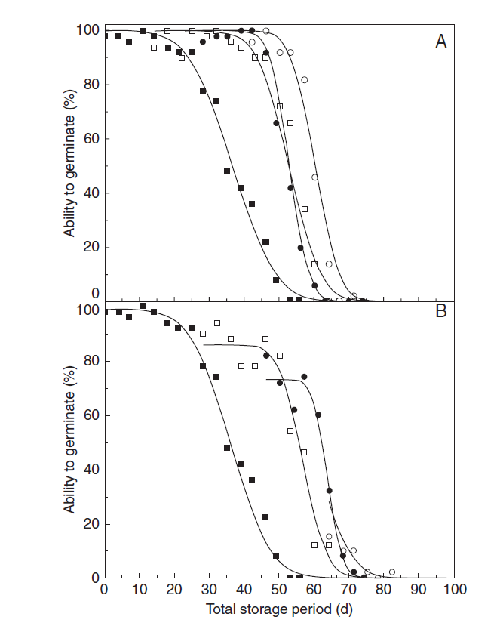
Alternative viability thresholds?
Digitalis purpurea seeds stored at 45°C, 60% RH throughout ( , both graphs).
Seeds stored 14 days, primed & returned to storage ( ); after 14 days, primed a 2nd time & returned to storage ( ); after 14 days, primed a 3rd time & returned to storage ( ).
Seeds stored 28 days, primed & returned to storage ( ); after 18 days, primed a 2nd time & returned to storage ( ); after 18 days, primed a 3rd time & returned to storage ( ).
Figure 3 in Butler et al. (2009). Priming and re-drying improve the survival of mature seeds of Digitalis purpurea during storage. Ann. Bot. 103, 1261–1270.

Slide 16
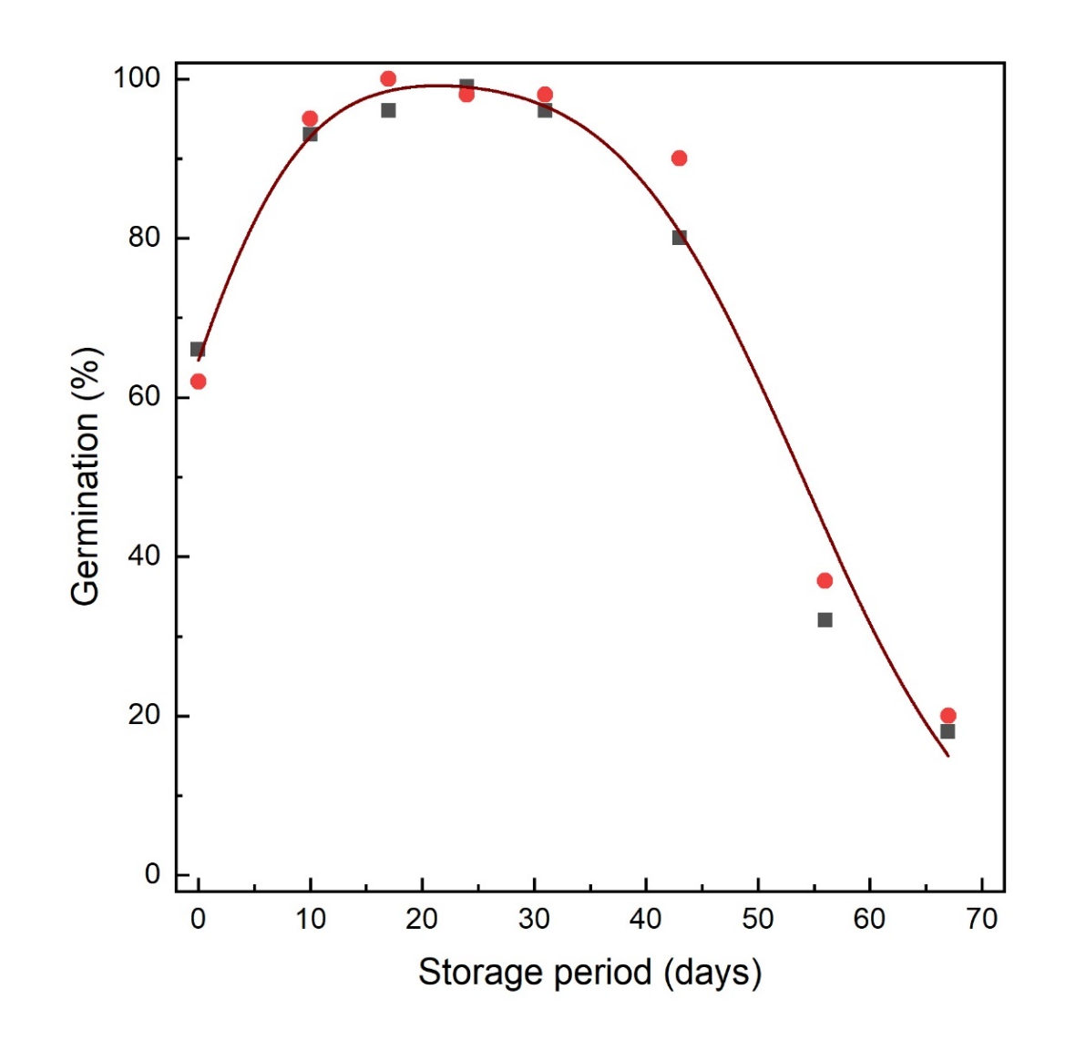
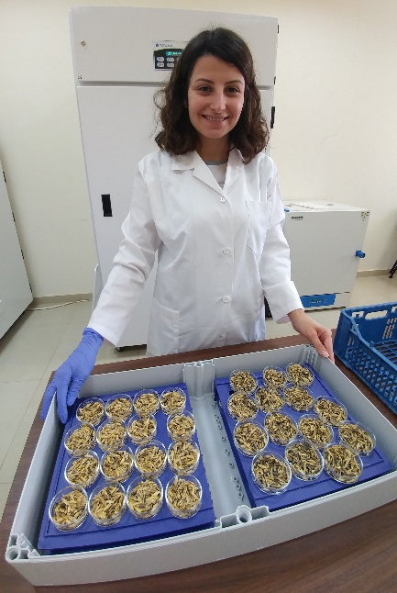
Alternative viability thresholds?
Seeds of Triticum turgidum subsp. dicoccoides (IG 46508) in experimental storage.
Comparing the effects of two post-harvest treatments on subsequent longevity in experimental storage.
Data from Rama Jawad (ICARDA).
For a genebank, it’s important to assess the seeds at the end of a germination test, especially the initial test

Slide 17
Making decisions based on one / few tests
Importance of experience
Importance of evaluating the seeds that do not germinate
Take another sample to confirm the viability result

Slide 18
Outline
A seed lot as a population of seeds, seed survival curves and genebank viability thresholds
Pre-storage factors that can impact the subsequent longevity of seeds when they are placed into genebank storage
Are current genebank storage conditions acceptable or not?

Slide 19
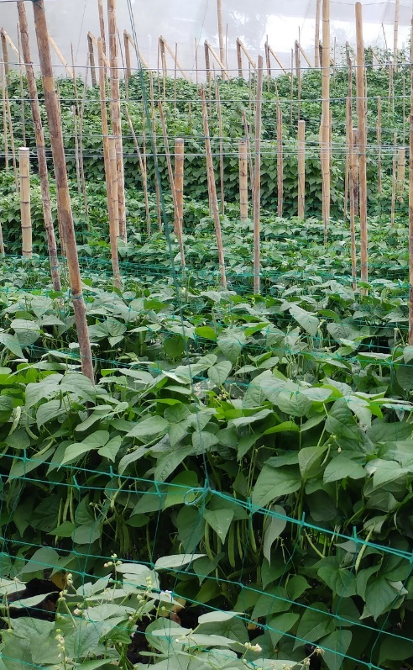
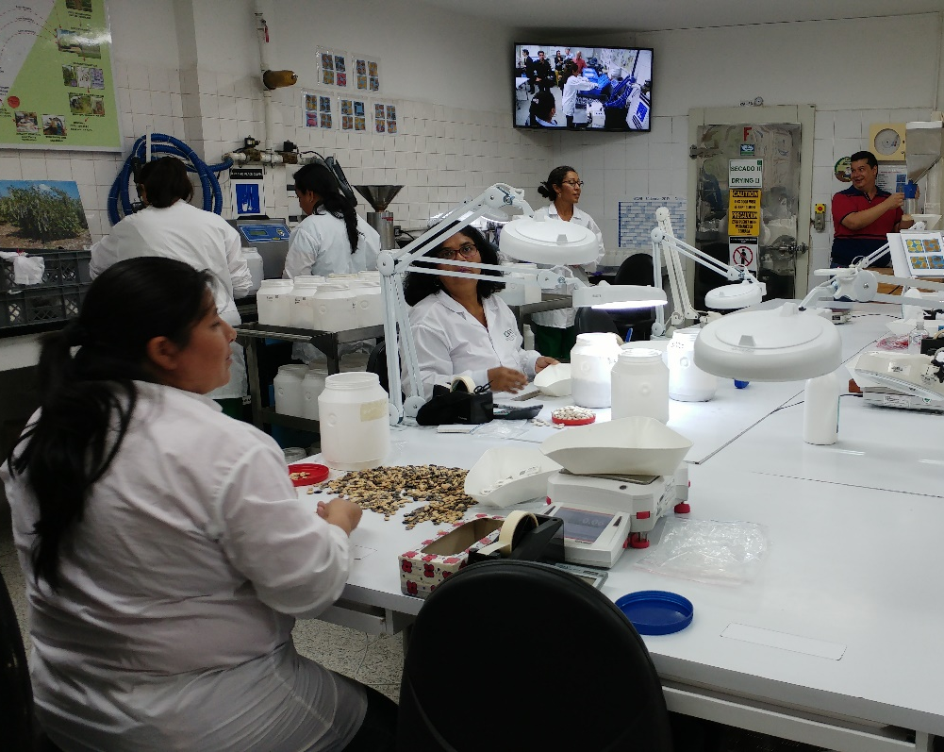
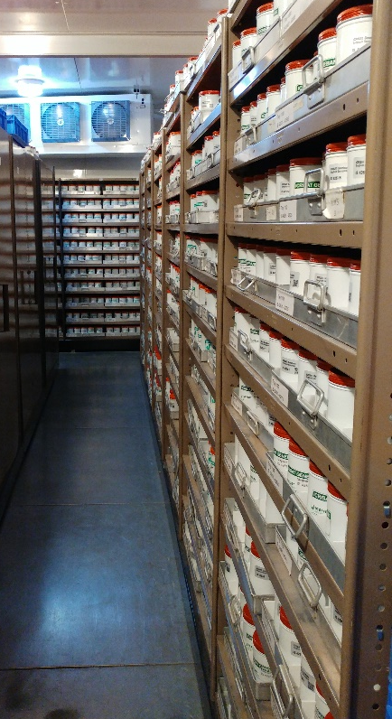
Everything that happens before storage can affect subsequent longevity in storage
Timing
of harvest
Duration of processing
In the field
During seed processing
Storage
Photos of bean regeneration and seed processing at CIAT; genebank storage at ICRISAT.

Slide 20
Seed development
Mass maturity
Moisture content
Dry weight

Slide 21
Seed development
For wild species, harvest as close as possible to the time of natural seed dispersal.
Mass maturity
Seed dispersal
Dry seed germination (‘desiccation tolerance’)
Fresh seed
germination
Longevity

Slide 22
Seed development
Mass maturity
Seed dispersal
Moisture content
Harvest maturity
Longevity

Slide 23
Seed drying after harvest
Data from Hay et al. (2015): 20 Oryza sativa accessions harvested harvested at 24, 31, 38 and 45 DAF, and dried in the genebank drying room.
Longevity measured as p₅₀ (seed storage experiments)

Slide 24

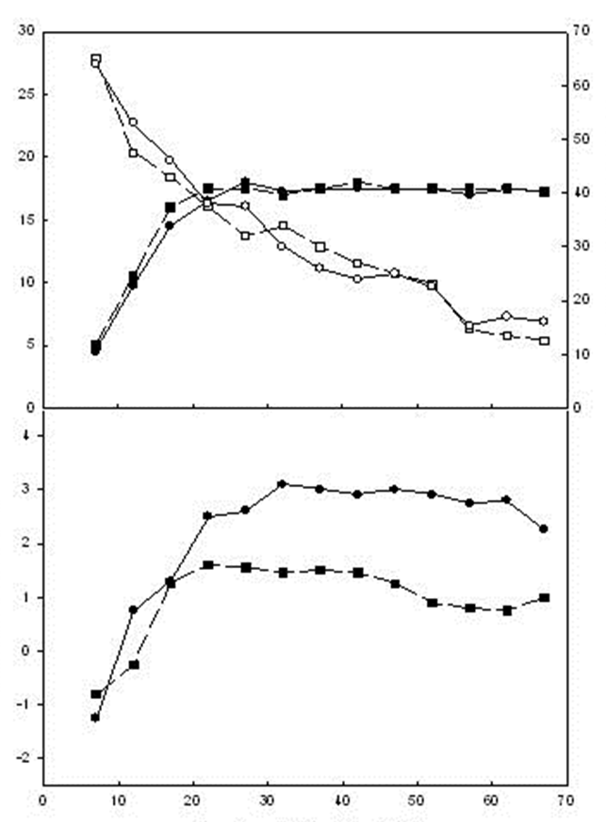
Conditions during seed development
Japonica rice cv. Taipei 309 seed development
28/20°C (●, ○) (≡ Tsukuba, Japan)
32/24°C (■, □) (≡ Los Baños, Philippines)
Seed dry weight (solid symbols)
Moisture content (open symbols)
Difference in temperature had no effect on seed filling but considerable effect on the pattern of seed quality development and maximum quality attained.
From Ellis et al. (1993). Ann. Bot. 72, 583-590.
Mean seed dry weight (mg)
Seed moisture content (% fresh weight)
Potential longevity (NED)
Days from 50% anthesis

Slide 25
Conditions during seed development
Rapid cycling Brassica seed development – effect of terminal drought
Continuous irrigation (●)
Irrigation stopped 16 days after pollination ( )
Irrigation stopped 24 days after pollination (■)
Arrows at base indicate timing of maximum dry weight (MM)
From Sinniah et al. (1998). Ann. Bot. 82, 309-314.

Slide 26

Seed drying after harvest
Data from Whitehouse et al. (2015): 20 Oryza sativa accessions harvested on one occasion, between 24 and 48 days after flowering, dried in the genebank drying room (‘DR’; 15% relative humidity and 15°C) or initially dried with heated air in a batch dryer (‘BD’).
Seed storage experiments carried out and the time when viability reached 50% (p₅₀) determined as a measure of realtive longevity.

Slide 27
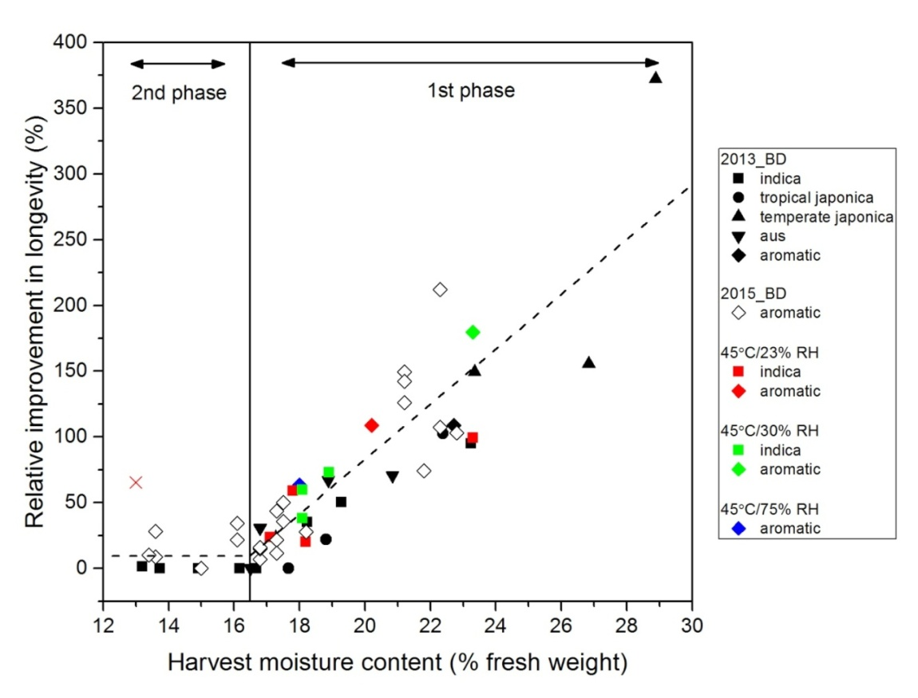
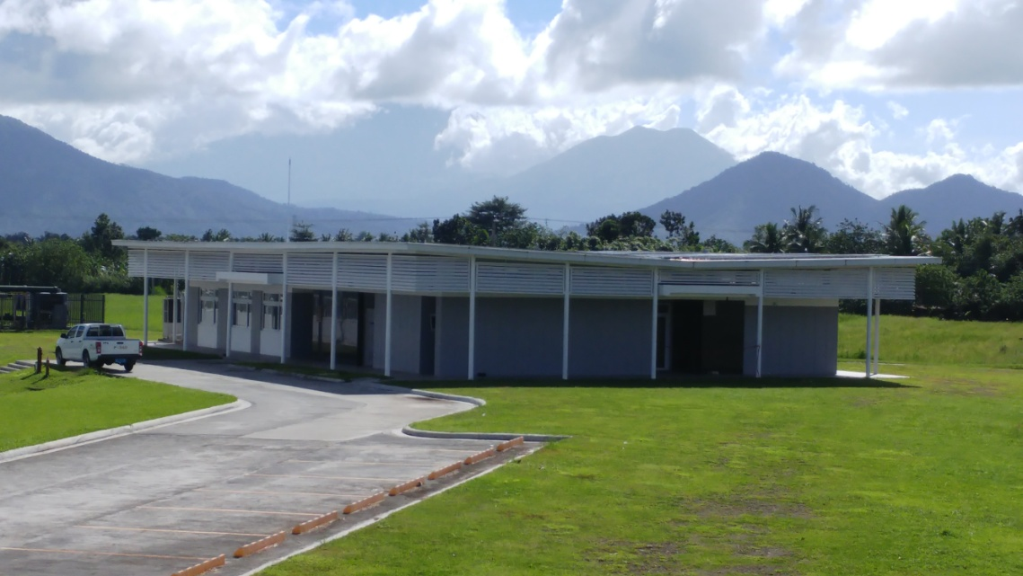
Seed drying after harvest
Introduced two-phase drying at IRRI
Seeds that had not dried on the plant, benefited the most from initial drying at the higher temperature
Genetic Resources Seed Processing Laboratory.
Initial drying room;
Final equilibrium drying room.
Whitehouse (2016).

Slide 28

Seed drying after harvest
Benefits of drying at a higher temperature (>15°C) also seen for wild Oryza species (right and in Timple and Hay, 2018).
Potential improvement for other species including soya bean and Bambara groundnut (IITA).
Sola Owoborode & Temitope Jones (IITA)

Slide 29
Seed development
Can what we do after harvest compensate for what happens before harvest?
Not enough known, but…
If it’s necessary to harvest before harvest maturity, hold / dry under conditions that simulate natural conditions (in a good season).
Mass maturity
Seed dispersal
Moisture content
Harvest maturity

Slide 30
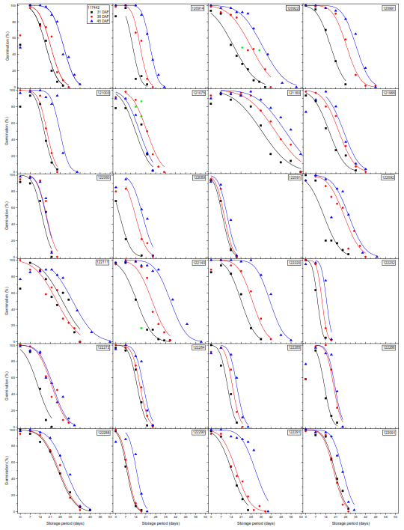

Discovery of seed longevity genes
Genome-wide association analysis: 299 Indica group Oryza sativa accessions. Seeds harvested at 31, 38 and 45 days after heading (different coloured symbols / lines). Standard seed storage experiments.
8 major loci associated with seed longevity parameters identified. Favourable haplotypes on chromosomes 1, 3, 4, 9 and 11 enhanced p₅₀ by ratios of 0.22–1.86.
Lee et al. (2019). Ann. Bot. 124, 447–460.

Slide 31
Length of the period from harvest to storage
More seed lots showing decline in viability?
Dormancy still present
Re-test data for IRGC Oryza sativa accessions regenerated in 1990, sorted according to length of time between harvest and banking (‘date processed’)

Slide 32
Variation in seed lot longevity within a species
Due to:
genetics;
conditions during seed development;
conditions at and timing of seed harvest;
how seeds are processed (drying & ‘holding’ conditions);
length of time before seeds are placed into storage.
Still need to monitor the viability of seed lots in genebank storage!
We know very little about the interactive effect of these factors on seed longevity.

Slide 33
Outline
A seed lot as a population of seeds, seed survival curves and genebank viability thresholds
Pre-storage factors that can impact the subsequent longevity of seeds when they are placed into genebank storage
Are current genebank storage conditions acceptable or not?

Slide 34
Genebank storage conditions
4.2.1 All seed samples should be dried to equilibrium in a controlled environment of 5–20°C and 10-25% RH, depending upon species.
4.2.2 After drying, all seed samples need to be sealed in a suitable airtight container for long-term storage; in some instances where collections that need frequent access to seeds or likely to be depleted well before the predicted time for loss in viability, it is then possible to store seeds in non–airtight containers.
4.2.3 Most-original-samples and safety duplicate samples should be stored under long-term conditions (base collections) at a temperature of –18 ± 3 °C and 15 ± 3% RH.
4.2.4 For medium-term conditions (active collection), samples should be stored under refrigeration at 5–10°C and 15 ± 3% RH.
(FAO, 2014).

Slide 35
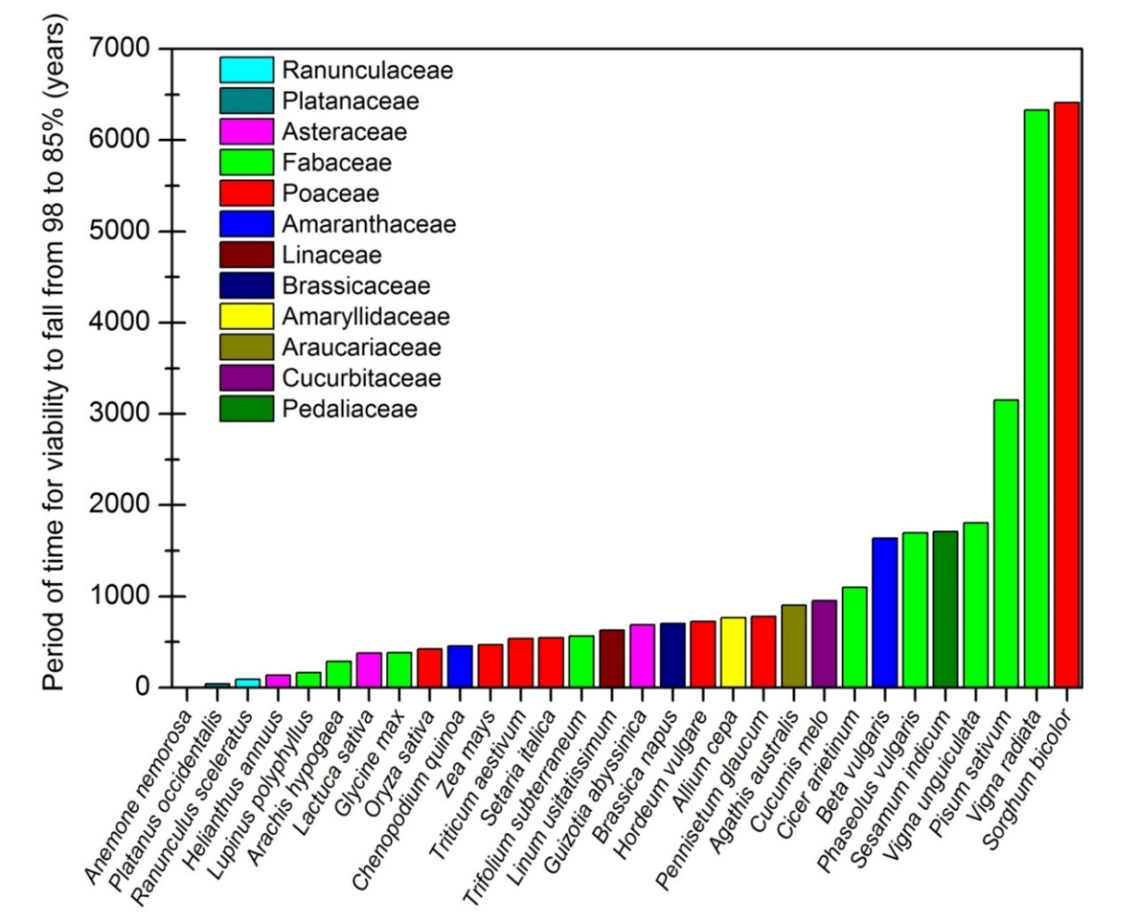
Predictions of longevity
Predicted times for viability to fall from 98 to 85% if the seeds are stored under long-term genebank storage conditions (in moisture-proof containers at -20°C after drying to equilibrium with 15% RH and 15°C).

Slide 36
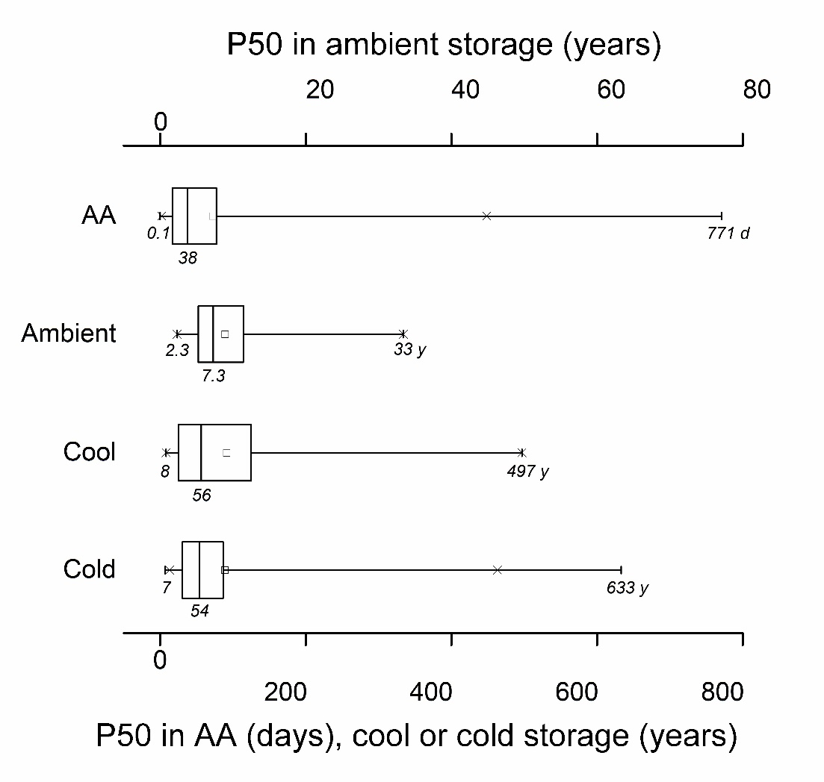
Actual data
Colville and Pritchard (2019). New Phytol. 224, 557-562.
Experimental storage conditions (60% RH, 45°C), 430 species. Data from Probert et al. (2009), Mondoni et al. (2011) and Merritt et al. (2014).
Ambient (temperate) storage, 92 species (Priestley et al. (1985).
Genebank data: cool (5°C, 3.5-9.5 % moisture content), 42 species. Data from Walters et al. (2005).
Genebank data: long-term, cold (initially at 5°C then -18°C, 4-8 % moisture content), 276 species. Data from Walters et al. (2005).
Considering diverse species, many (most) species have significantly poorer seed longevity than the maximum observed for different storage environments.

Slide 37
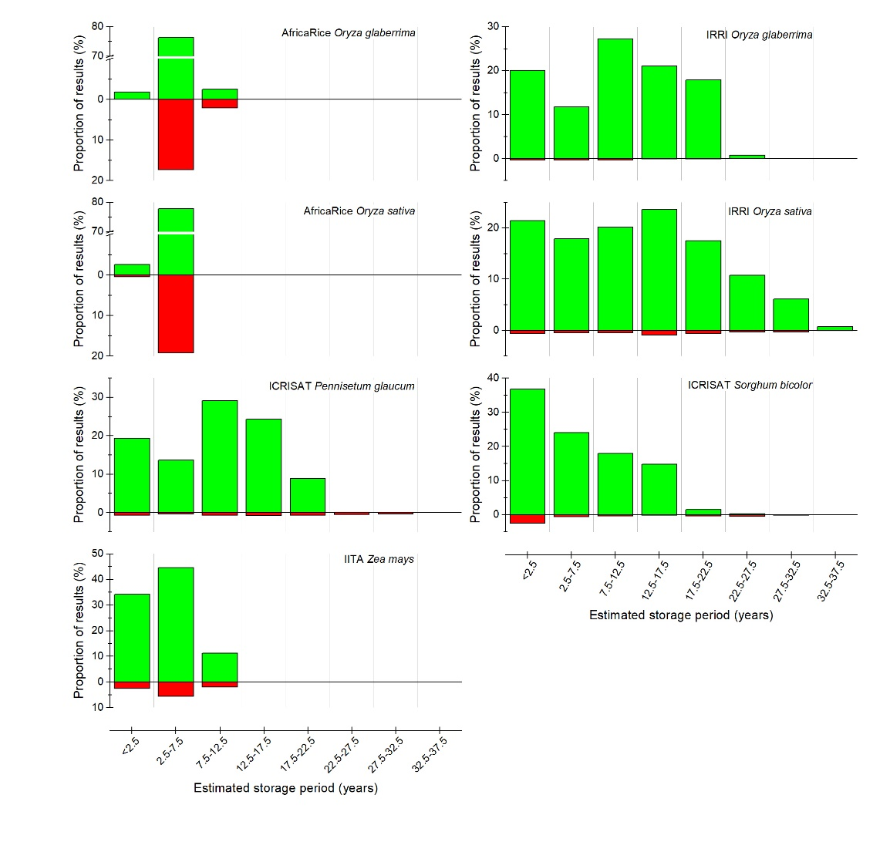
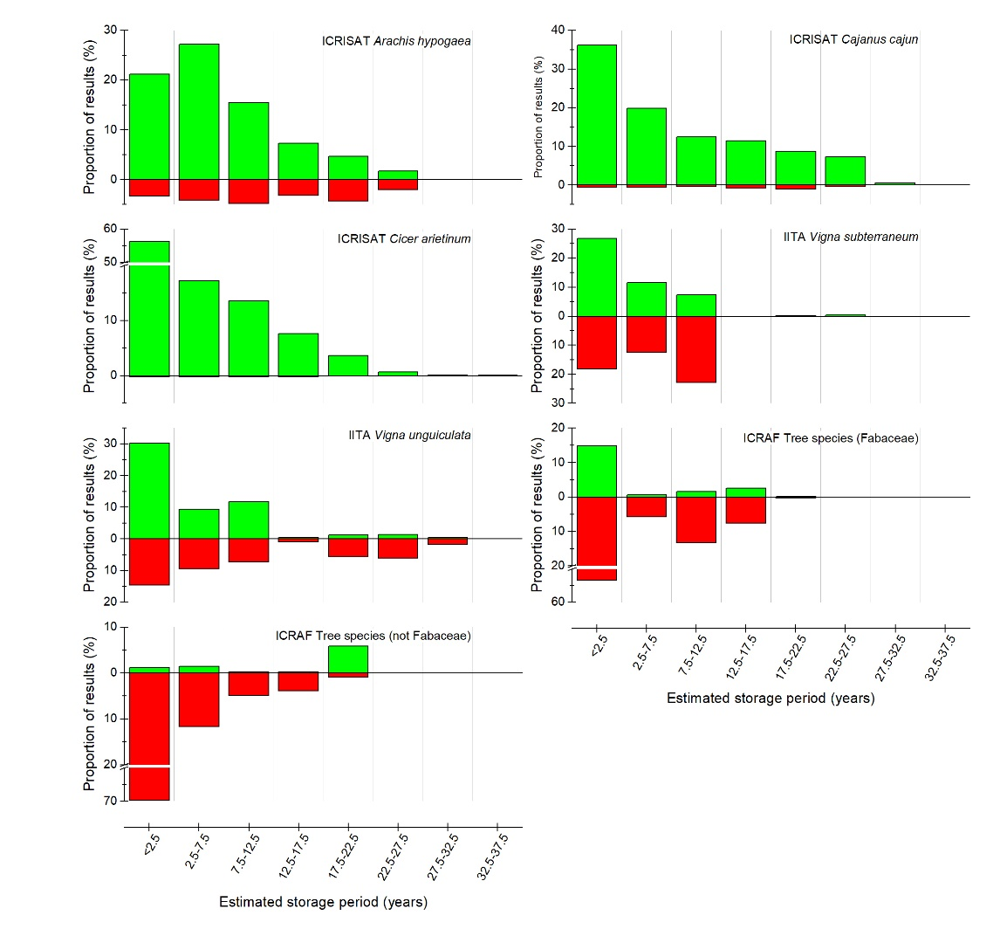
CGIAR viability monitoring data
Viability monitoring data for seeds in medium-term storage from seven CGIAR genebanks.
Green = proportion of results with >85% viability; red = proportion of results with ≤85% viability.
Hay et al. (in preparation).

Slide 38
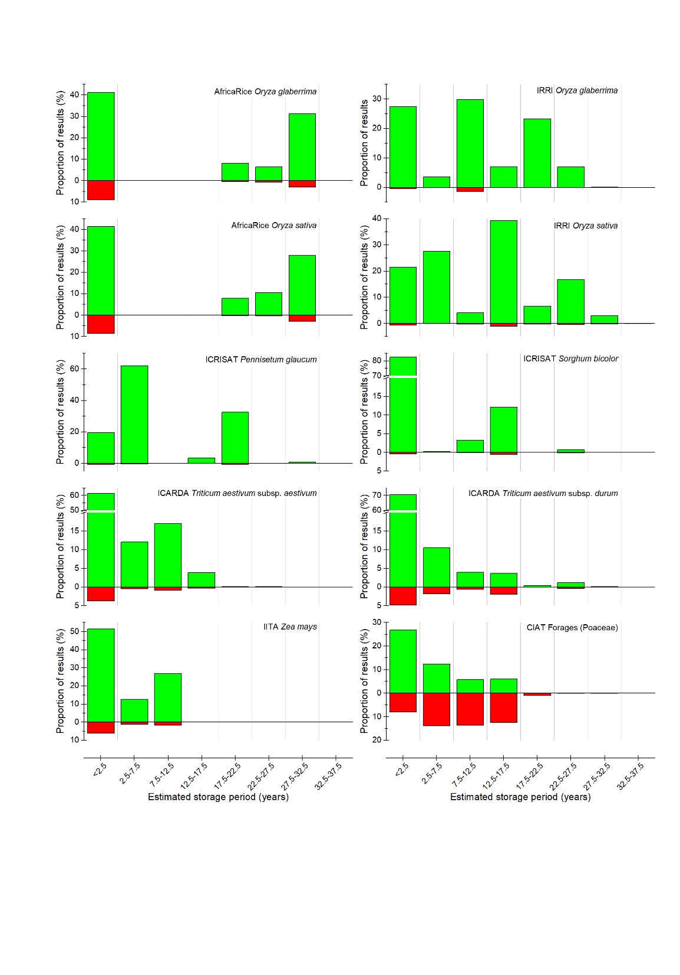
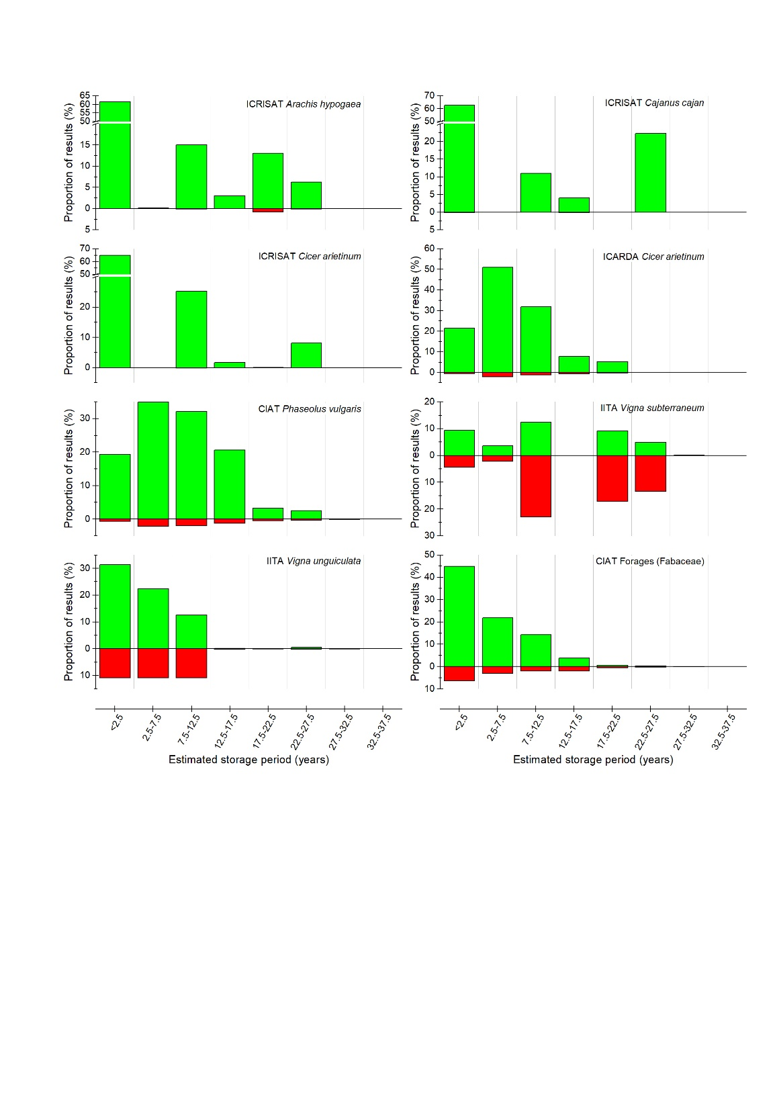
CGIAR viability monitoring data
Viability monitoring data for seeds in long-term storage from seven CGIAR genebanks.
Green = proportion of results with >85% viability; red = proportion of results with ≤85% viability.
Hay et al. (in preparation).

Slide 39
CGIAR viability monitoring data
High viability has been maintained for many seed lots over 30-35 years in medium- and long-term storage.
Hay et al. (in preparation).

Slide 40
CGIAR monitoring data
High viability has been maintained for many seed lots over 30-35 years in medium- and long-term storage.
Results are favourable compared with other studies (Walters et al., 2005).
Mean initial
Mean final
p₅₀
Hay et al. (in preparation).

Slide 41
CGIAR viability monitoring data
Some problem genera / species
Data from ICRISAT
Data from CIAT (LTS)

Slide 42
CGIAR monitoring data
Genebank conditions maintain viability well (enough) for most crop species.
Given predicted and achieved longevity of seeds of the various crop species, regeneration is primarily due to low seed number (often at harvest).
Need to optimize quantity of seeds produced and placed into storage to represent an accession (also based on expected demand – if there is demand).
For some species (Oryza?), which are relatively short-lived, we may be approaching ‘steady state’ operations; otherwise, genebanks are still too ‘young’.
Important to continue monitoring older seed lots, with the same or shorter viability monitoring intervals to get a better understanding of longevity in genebank storage.

Slide 43
CGIAR monitoring data
Genebank conditions maintain viability well (enough) for most crop species.
Given predicted and achieved longevity of seeds of the various crop species, regeneration is primarily due to low seed number (often at harvest).
Need to optimize quantity of seeds produced and placed into storage to represent an accession (also based on expected demand – if there is demand).
For some species (Oryza?), which are relatively short-lived, we may be approaching ‘steady state’ operations; otherwise, genebanks are still too ‘young’.
Important to continue monitoring older seed lots, with the same or shorter viability monitoring intervals to get a better understanding of longevity in genebank storage.
We’re doing OK, but we have a lot more to learn about seed longevity in genebank storage and the factors that influence that longevity to further optimise genebank operations.

Slide 44
Acknowledgements
Staff of the CGIAR genebanks with whom I collaborate through the Seed Quality Management (SQM) activity of the CGIAR genebank platform. SQM is funded through the CGIAR Genebank Platform.
Marie Noelle Ndjiondjop (AfricaRice).
Charlotte Lusty (Crop Trust).
Jae-Sung Lee (IRRI).
Stephen Timple (previously at IRRI).
Katherine Whitehouse (Australian Grains Genebank).
Richard Ellis (University of Reading, UK).
Thank you for joining the webinar.

