Slide 1
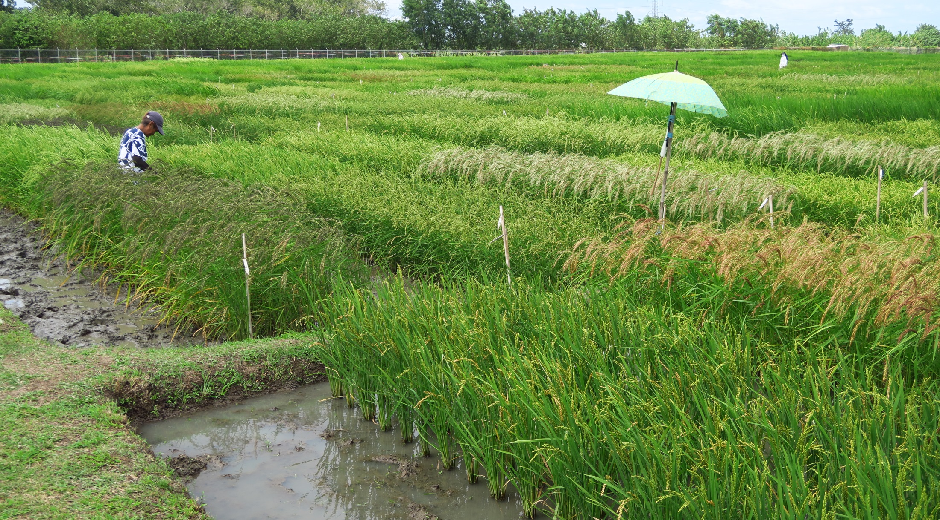
The future of genebanks: How far should the CGIAR genebanks dare to go? Ruaraidh Sackville Hamilton 17 June 2021

Slide 2
Outline
Background: needs and opportunities for genetic resources
Conserving and delivering the right resources
Conserving and delivering resources the right way
What will CGIAR genebanks do?

Slide 3
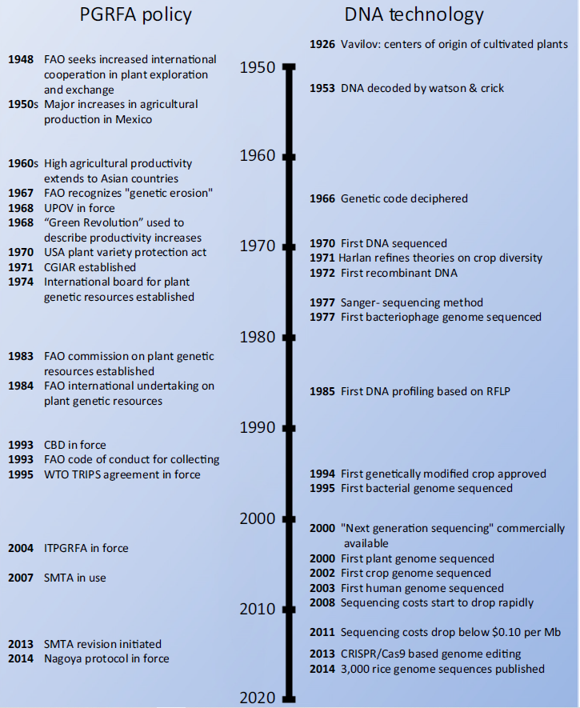
Coevolution of technology and policy
Roa et al 2016
Plant genetic resources: needs, rights and opportunities

Slide 4
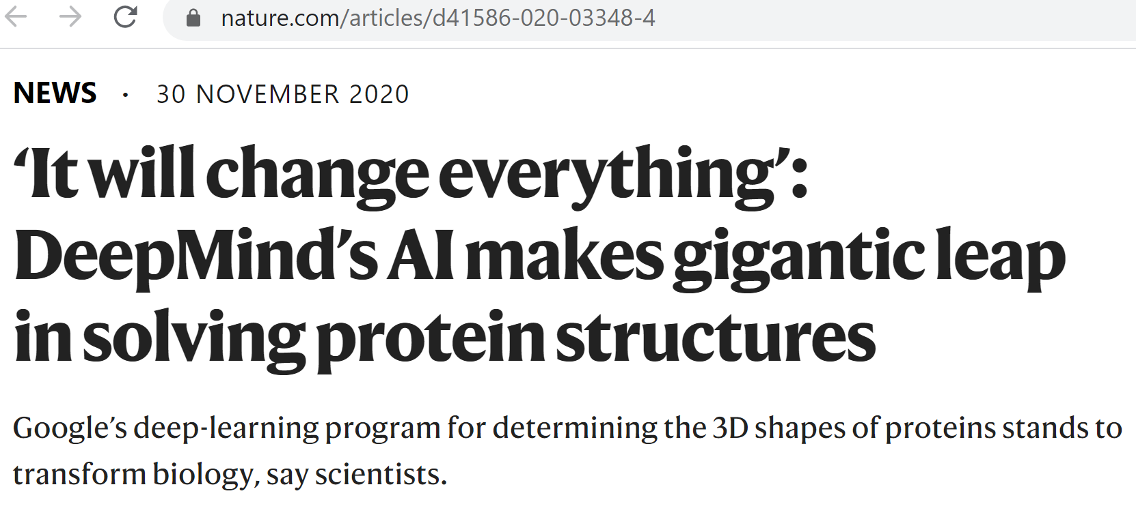
In some cases, AlphaFold’s structure predictions were indistinguishable from those determined using ‘gold standard’ experimental methods such as X-ray crystallography and, in recent years, cryo-electron microscopy

Slide 5
Immediate impact vs long term sustainability
Global Crop Diversity Trust created to reduce conflict
By funding essential genebank operations
Not adequate: need synergies
CGIAR Excellence in Breeding: Optimizing breeding schemes
“It is a common practice for breeding programs to make wide crosses based on the belief that genetic diversity needs to be expanded, rather than [build] an understanding of quantitative genetics principles or knowledge of how diversity changes in a breeding program. As a result, the allele frequency of important traits can be negatively impacted” https://excellenceinbreeding.org/sites/default/files/manual/EiB-M2_Germplasm%20%20%20trait%20introgression_01-06-20.pdf
Rate of genetic gain: $∆_{g}={\left(i∗{r∗σ}_{A}\right)}/L$

Slide 6
What are the CGIAR genebanks for?
Conserving and facilitating use of diversity of mandate species:
The diversity that was lost in the green revolution?

Slide 7
What are the CGIAR genebanks for?
Conserving and facilitating use of diversity of mandate species:
The diversity that was lost in the green revolution?
Heritage varieties?

Slide 8
What are the CGIAR genebanks for?
Conserving and facilitating use of diversity of mandate species:
The diversity that was lost in the green revolution?
Heritage varieties?
Functional variants of genes not in breeders’ working collections?

Slide 9
What are the CGIAR genebanks for?
Conserving and facilitating use of diversity of mandate species:
The diversity that was lost in the green revolution?
Heritage varieties?
Functional variants of genes not in breeders’ working collections?
Genomes of immediate interest to breeders?

Slide 10
Don’t underestimate the amount of diversity!
In rice:
~ 50,000 gene models
On average, ~ 10 functionally distinct variants at each
→ potentially distinct phenotypes
$$\prod_{i=1}^{50000}{v_{i} } ≅ {10}^{37,000}$$

Slide 11
10^{37,000}???? How many ????
Seconds until the end of the universe
$$≅{10}^{17}$$
Diameter of universe
Diameter of smallest particle
$$≅{10}^{45}$$
Number of atoms in the universe
$$≅{10}^{82}$$
$${10}^{37,000}$$
$${10}^{37,000−82}$$
= number of atoms in universes
What if 99.9999% of haplotypes are lethal?
→ distinct viable haplotypes
$${10}^{37,000−8}$$

Slide 12
Implications
We have conserved 0% of the potential diversity of current crops
Don’t even try to do better
Achievable: conserve and document the function of all functional variants of all genes
Genebanks’ essential long-term task
Exploring 10^{37,000} combinations of functional variants is an infinite opportunity for invention until the end of time
Static conservation of genomes from the 1960s is not appropriate
Genebanks’ role in accelerating evolution?

Slide 13
30 years from now: Conserving and delivering the right resources

Slide 14
30 years from now: all variants of all genes known and catalogued
Indels and SNPs in coding regions
Epigenetic variants
Functional variants in non-coding regions
For all genebank accessions and other known varieties
(so we know what the breeders don’t have)
Most functional variants annotated with function
Technology?
[Son of] WGS, GBS …?

Slide 15
30 years from now: accession-specific values for conservation and use estimated
Future value
Number of functional variants in the accession absent from breeders’ materials, weighted by rarity in genebanks
Conserve long-term, regardless of value for current breeding
Current value
Pre-breeding materials with important functional variants in useable genetic backgrounds
Promote use; discard if not used
Heritage value
From a country that considers the variety part of its heritage (and that needs CGIAR to provide security?)

Slide 16
30 years from now: collection composition optimised
Small stable conservation-oriented collections
Large dynamic use-oriented collections
Ongoing:
Acquisition of new accessions with high future, current or heritage value
Creation of new accessions with increased future or current value
Disposal of accessions with low future, current and heritage value
Coordinated among genebanks

Slide 17
30 years from now: delivery well matched to users’ needs
User =
Grower, exploring accessions for use on farm
Researcher, exploring diversity and value in genebank
Pre-breeder, creating novel value in genebank
Breeder, creating novel varieties
Users’ changing needs monitored
Algorithms to convert users’ needs into “ideogenomes”
Algorithms to optimise breeding pathway from current materials to ideogenomes

Slide 18
30 years from now: Conserving and delivering resources the right way

Slide 19
30 years from now: policy in harmony with technology 20 years from now
Acquisition, conservation, delivery and use compliant with all applicable regulations
International fora
Plant Treaty
CBD / Nagoya Protocol / Cartagena Protocol
International Plant Protection Convention
Future agreements?
Ongoing engagement
To ensure continuing compliance
To devise and offer technically effective and efficient solutions

Slide 20
Management targets
(Unchanged) accessions must be
viable
healthy
genetically true-to-type
protected against risks of loss
available to use
Accession management tailored to value
e.g. no viability testing for high current value

Slide 21
21st century genebank, materials and process management
Enhanced quality, increased throughput, reduced costs
Automated seed handling
Withdrawal from and deposit in storage
Sorting, counting, weighing, labelling, packaging, planting
Testing for viability, health and genetic integrity
Automated phenotyping, genotyping, sequencing
Staff retrained for higher throughput

Slide 22
How should we get there?

Slide 23
Building knowledge
Smart evaluation
To increase knowledge of diversity and genetic control of traits
Partial evaluation of prioritised subsets for prioritised traits
Used to direct future evaluation
Adapt and adopt automated / image-based phenotyping
Characterization
Basis for monitoring genetic integrity
Crop-specific migration to DNA-based fingerprinting
Image-based phenotyping for key descriptors e.g. e-seed file for seed sorting
Genotyping and sequencing
Crop-specific migration towards gene-based methods
Some whole-genome sequencing

Slide 24
Supporting innovation
Breeder- and researcher-oriented materials
Research populations optimised for gene discovery & annotation
Including subsets for whole genome sequencing + GWAS
Novel genetic resources
Maximise creation of new combinations of genes
Expose hidden variation
Complementing breeders’ pre-breeding
Digital genebanks
Access to info as important as access to material
Searchable info on materials in genebanks and elsewhere
Distributed info, in numerous systems
Major investment required to integrate
GLIS is a start

Slide 25
Conserving and delivering resources the right way
Improvements in each genebank’s efficiency, effectiveness, throughput, quality
SOPs
Automation
Larger scale improvements
Service provision
CGIAR system
Global integration
R&D for improved effectiveness
Seed longevity
Cryopreservation & tissue culture
CWR, forages, trees
Phytosanitary controls

Slide 26
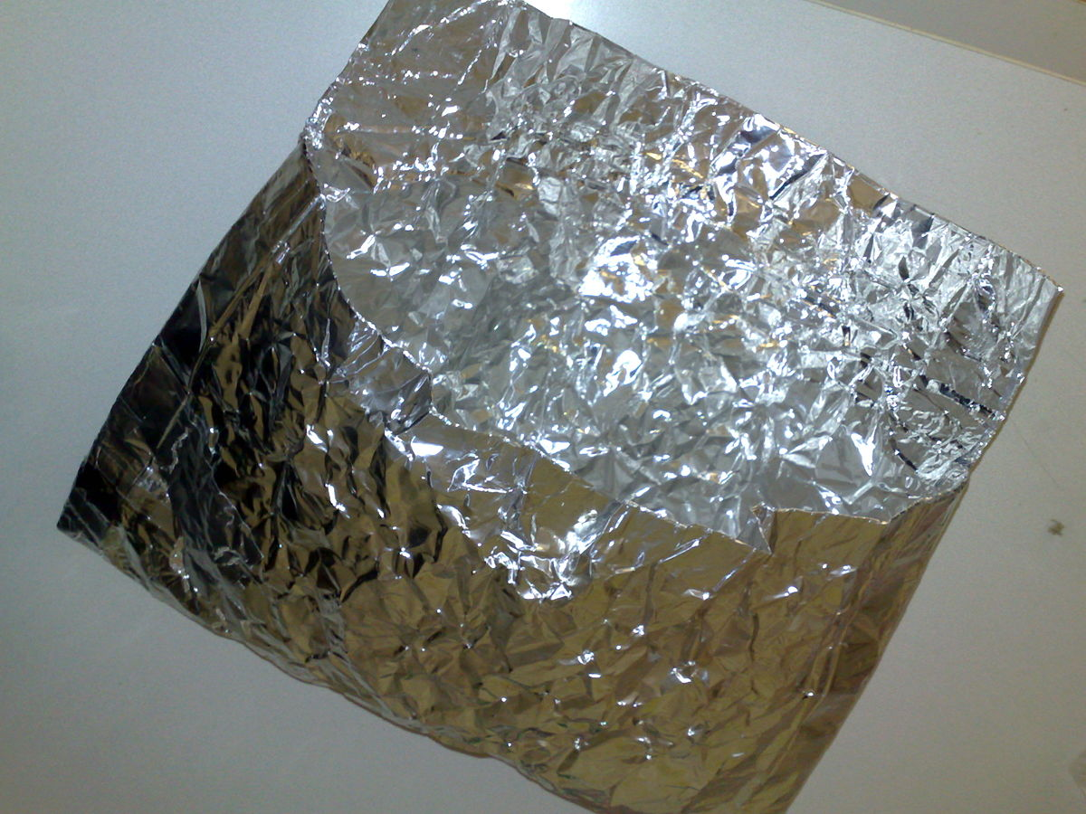
Seed withdrawal for distribution: calling out for automation
Check
Equilibrate
Open
Check
Check
Test
Pack
Label
Check
Ship
Check
Weigh/count Pack Label
Check,
Weigh/count
Seal
Re-dry

Slide 27
Service provision: Not every genebank has to do everything in-house
Long-term base conservation
Distribution
Regeneration / re-culturing
Phenotyping
Health & viability testing
Genetic integrity testing
Phytosanitary control
Georeferencing & spatial analysis
Providing public access to data
Engaging in policy discussions

Slide 28
One CGIAR: should we adopt a USA/India-like model?
Set of regeneration hubs
Optimised for production of high-quality seed
Replaces seed in distribution hub, central facility, safety backup, SGSV
Central facility LTS & MTS
Optimised for long-term security
Full testing for viability, health, genetic integrity
Set of distribution hubs
Optimised for interaction with users

Slide 29
One CGIAR: should we adopt a USA/India-like model?
Single management
Benefits of scale within crop groups: automation, specialisation, harmonisation of standards
Easier engagement with international fora
International transfers for genebank management
Politically challenging
Single global facility not possible or desirable
→ 2-3 centralised facilities?

Slide 30
Global integration: whither the GPA and ABS?
Farmers
Local communities
CGIAR Breeders
Other breeders
Seed companies
Researchers
CGIAR genebanks
Other International genebanks
National genebanks
Community seedbanks
Private gene banks
International fora
National law & policy makers

